Slide 1
Haiti Relief 2019
St. Jude Catholic Community
Needs & Accomplishments
Notes:
We want to take this opportunity to say thank you for your noble cause by supporting the Haiti Relief Projects during 2019.

Slide 2
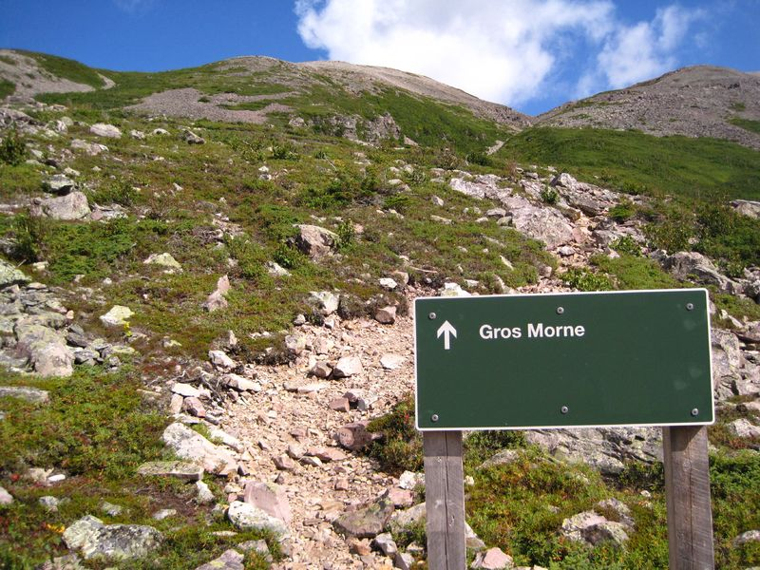
Haiti: "LAND OF HIGH MOUNTAINS"
Notes:
During 2019 we embarked in a unique mission in Haiti in the area of Gros-Morne, Riviere-Mancelle, specifically in the village of Kalabat.
Population of Haiti: Approx. 11 million
There is no electricity or clean water, and there is a lack of education for the children that live in the mountains; in many ways there are isolated in a remote area of Haiti.
No street, No Highway.

Slide 3
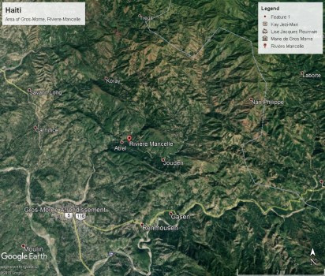
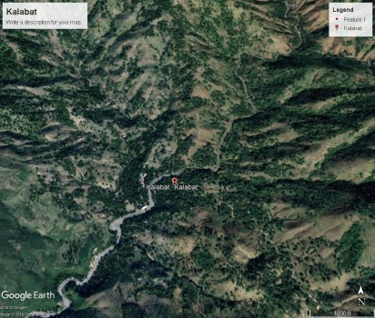
Haiti: "LAND OF HIGH MOUNTAINS"
Riviere-Mancelle
Kalabat
Notes:
Areas of Riviere-Mancelle and Kalabat in the mountains.
Population of Riviere-Mancelle: Approx. 20,000 people.
Walking distance from Gros-Moune to Kalabat: 4 hours round trip.

Slide 4
Projects 2019
Solar MP3 Lanterns
Water System
Housing
Kindergarten (Education), located at Garde Saline, North East side close to the border of Dominican Republic.
WIFI System (Wireless Communication)
Notes:
These are the 5 projects that we supported during 2019 to improve the quality of life of our brothers and sisters in Kalabat.
Solar MP3 Lanterns, Water System, Housing, Education and WIFI System (Wireless Communication).

Slide 5
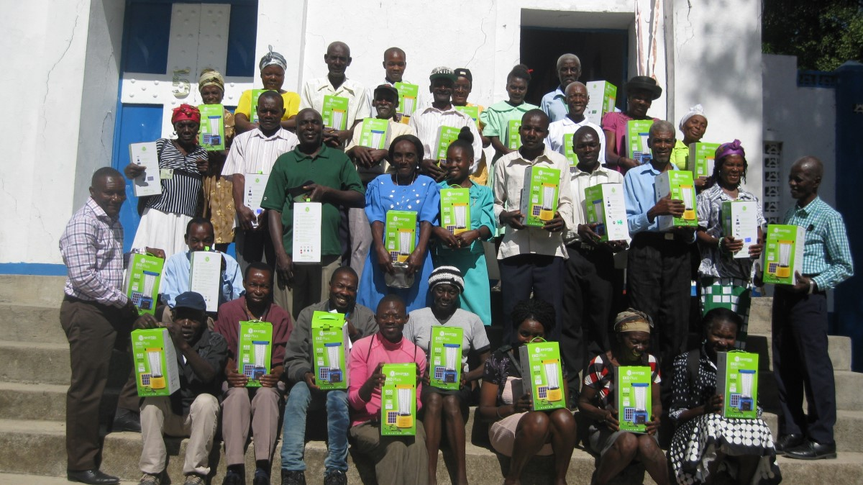
Solar MP3 Lanterns
Notes:
The distribution of solar lanterns to teachers and midwives. We distributed 274 solar lanterns in the area of Riviere-Mancelle. Our cost for each the lantern is $35.00. We sold each lantern for $0.50, and the money raised is used to repair the water system of Kalabat to provide drinking water from seven public fountains.
On January 5th, 2020, we will distribute 600 Solar Lanterns in Kalabat. Our goal is to reach 20,000 families in the area of Riviere-Marcelle.
We also want to acknowledge the support from St. Timothy, St. Teresa, Queen of Peace and Blessed of Trinity.

Slide 6
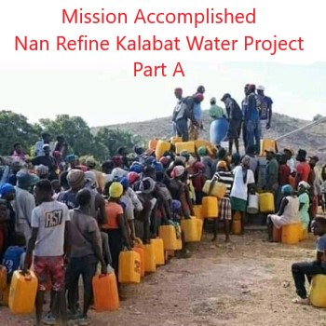
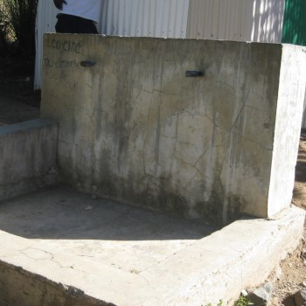
Water System: Nan Refine Kalabat Part-A
Beginning no water
Notes:
Brings drinking water from the Nan Refine Spring to Kalabat.

Slide 7
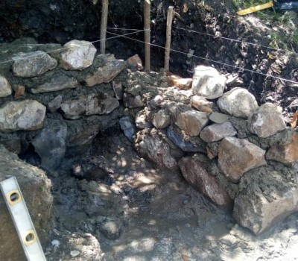
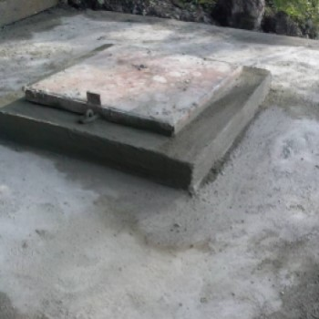
Water System: Nan Refine Kalabat Part-B
Beginning
Mission Accomplished
Notes:
New Spring of Nan Refine increasing the amount of clean drinking water for the system at the Nan Refine Kalabat. There is a public fountain in the schoolyard of Sainte Cecile Catholic School.

Slide 8
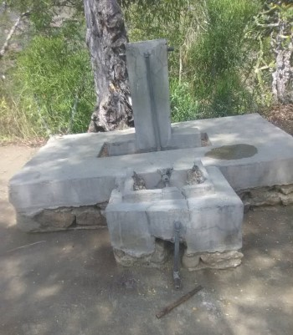
Water System: Nan Filion
Beginning
Notes:
Nan Filion Water System Project in great need of repair. We need your support
A Christmas Gift of $10.00 per parishioner will cover the cost.
We have a great mission for the year of 2020.

Slide 9
Estimated Cost: $6,000.00
Materials | Description | Qty | Cost per unit | Total Cost
PVC Pipes | 2" X 20' | 220 | $20.00 ea | $4,400.00
Galvanized Pipes | 2" X 20' | 5 | $63.00 ea | $315.00
Cement | Cement | 25 | $9.00 ea | $225.00
Transport & Labor |  |  |  | $1060.00
Grand Total |  |  |  | $6000.00
Notes:
Estimated Cost: $6000.00

Slide 10
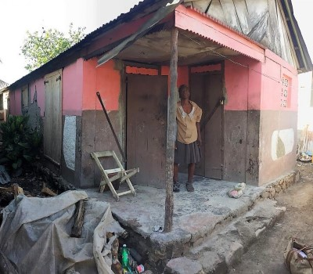
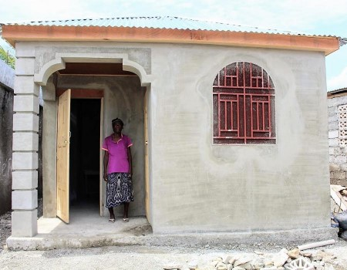
Housing: Mme Esther Jean (FIFI)
Beginning
Mission Accomplished
Notes:
Damaged houses during the October 2018 earthquake.
Mme Esther Jean (FIFI) is the owner of the house and living with her family.

Slide 11
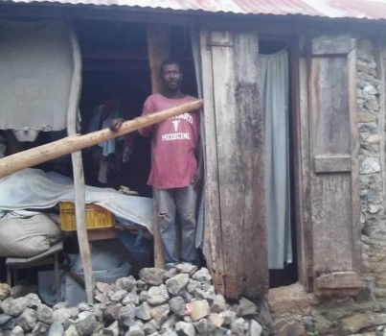
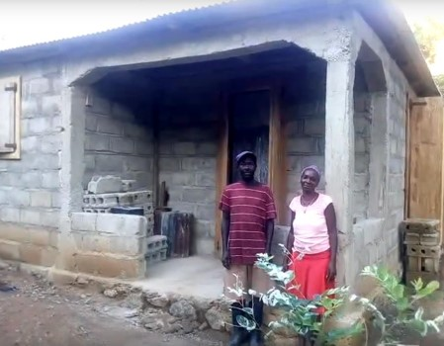
Housing: Cilencieux Almonde
Beginning
Working in Progress
Notes:
Cilencieux and his wife Gerta are parents of 7 children. Some of the children are in high school and others in elementary school.
The house was destroyed by the October's earthquake in 2018.

Slide 12
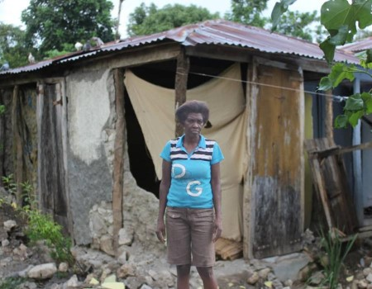
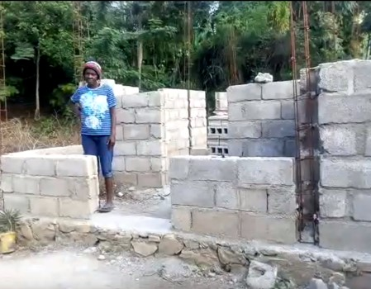
Housing: Illiane Petit-Jean
Beginning
Work in Progress
Notes:
Damaged houses during the October 2018 earthquake.
Illiane is a single mother of 9 children. Six of them are alive. She focuses very much on the education of her children.
Your donation and contributions are greatly needed for the completion of Illiane’s house in 2020. Thank you for supporting the efforts.

Slide 13
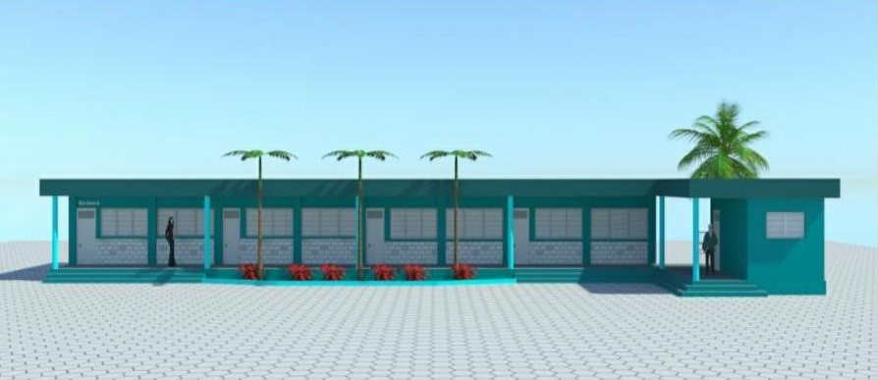
Garde Saline Kindergarten Project Plan
Notes:
Mary Lyon, a longtime St. Jude Catholic Community parishioner, is supporting the Montfort Fathers of Haiti in building the kindergarten of Garde Saline, North East side close to the border of Dominican Republic. Garde Saline is one of the poorest fishermen villages of the state of Fort Liberté in Haiti, where 50% of the population, in general don't attend schools in Haiti and for Garde Saline it is 60%.

Slide 14
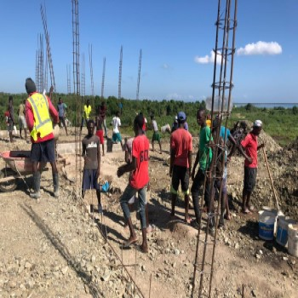
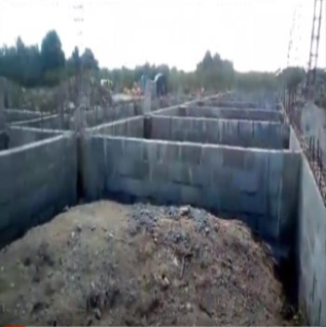
Kindergarten: Work in Progress
Notes:
Our plan is to open the kindergarten by January 2020. The kindergarten will be the first school in the state to provide clean water and electricity 24/7, also utilizing solar panel technology as a renewable source of energy. It's our goal to serve 160 students in the school. With your donations and contributions, we can bring hope to families in Garde Saline, one of the poorest fishermen villages of the state of Fort Liberté in Haiti.
The cost to educate a child is $100.00 per year. We can make a difference by working together to bring joy and hope to God's children.
There is also a great need for school supplies and to provide nutritious non-perishable food for the children.

Slide 15
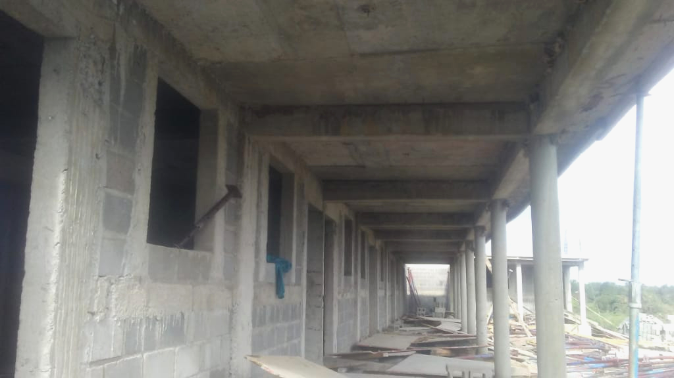
Kindergarten: First Story Section
Notes:
Kindergarten first story section in progress. The Kindergarten will be a two story building.

Slide 16
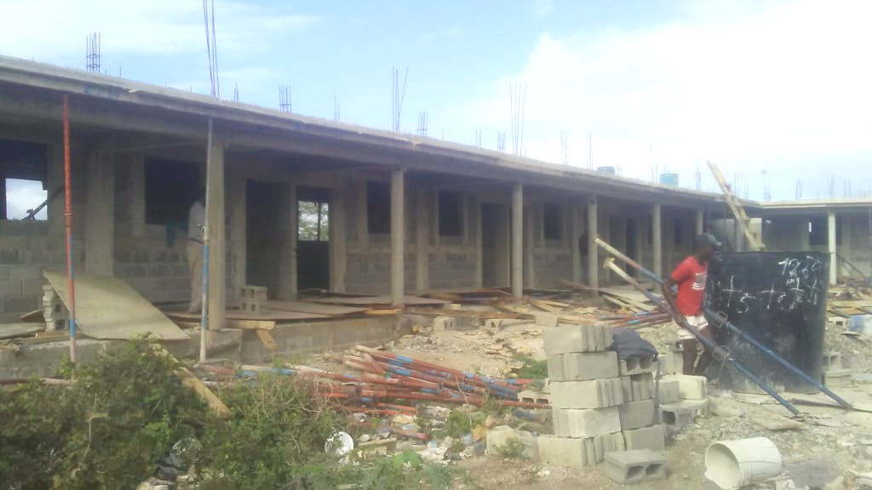
Kindergarten: First Story Section
Notes:
Kindergarten first story section in progress. The Kindergarten will be a two story building.

Slide 17
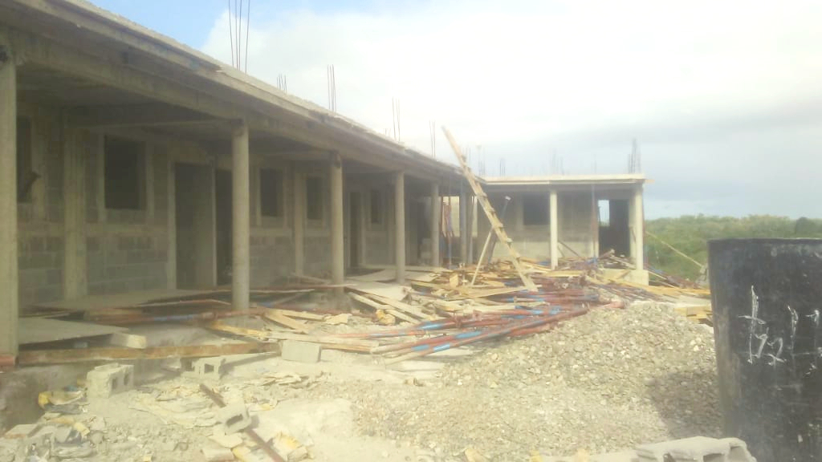
Kindergarten: First Story Section
Notes:
Kindergarten first story section in progress. The Kindergarten will be a two story building.

Slide 18
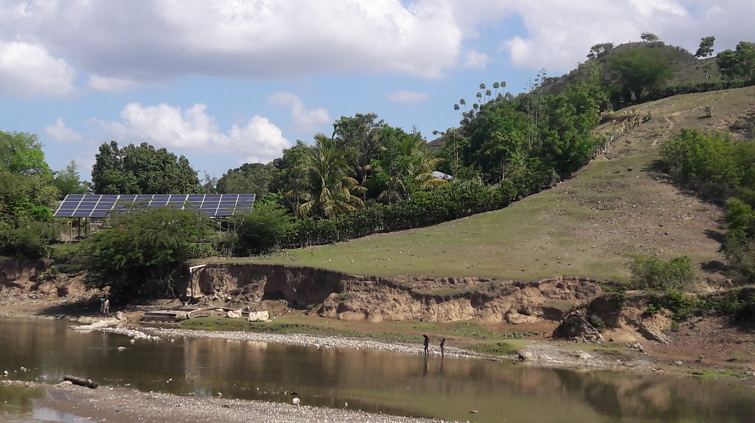
Garde Saline Water System Project
Notes:
Garde Saline Water System Project in progress in 2020

Slide 19
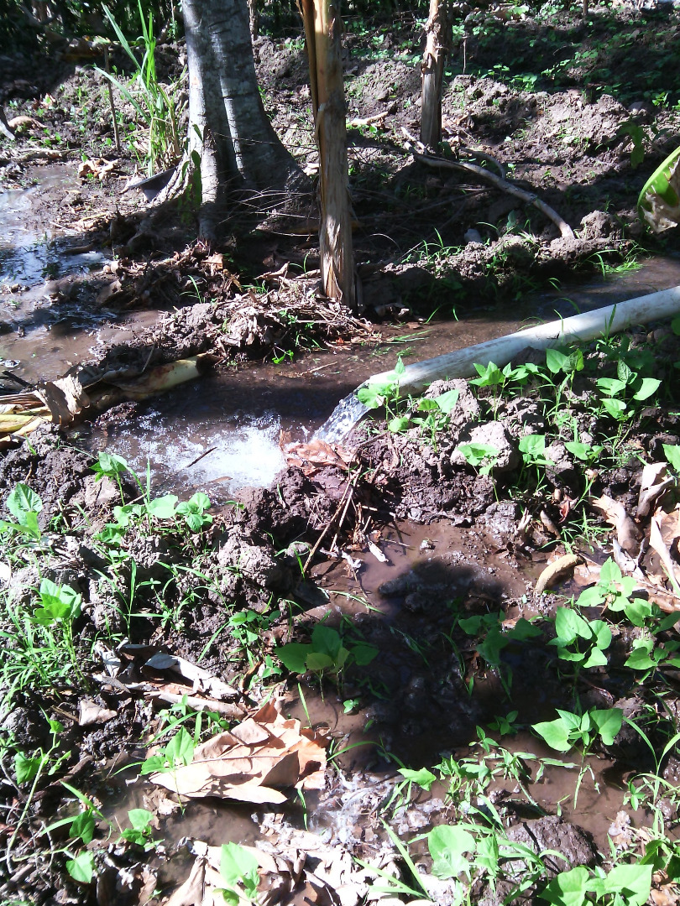
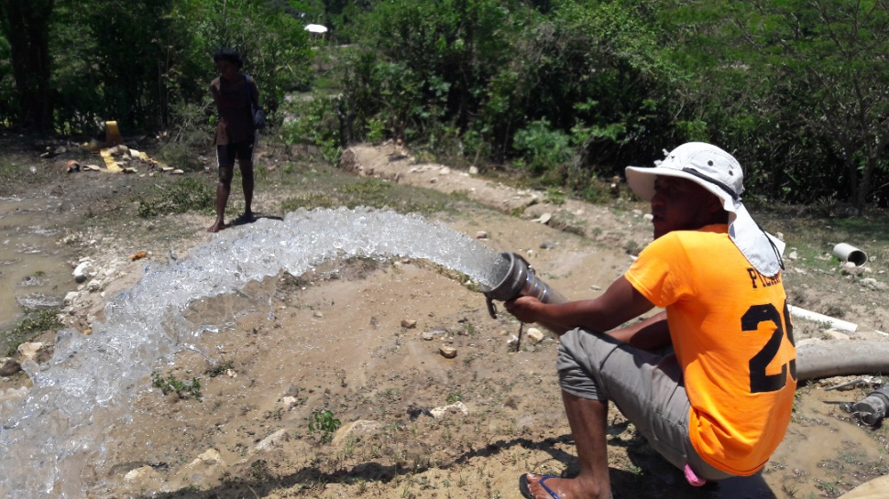
Garde Saline Water System Project
in Progress
Thank you for your Support
Notes:
Garde Saline Water System Project in progress in 2020

Slide 20
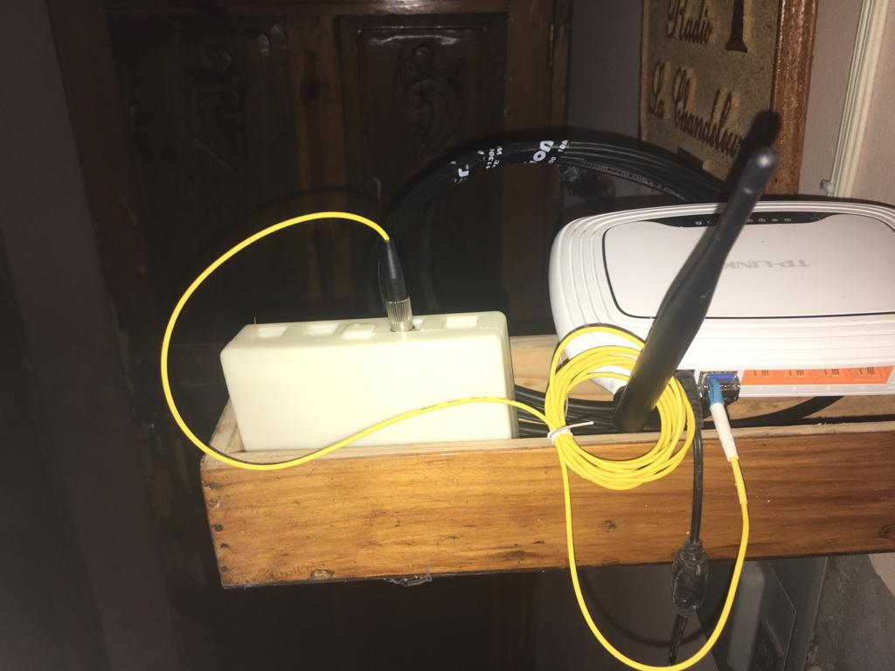
WIFI: Wireless Communication
Notes:
Allowing computers, smart phones, tablets and other devices to connect to the Internet.
WIFI installation will be completed on December 28th in Kalabat.
Fr. Bart will be celebrating his 33rd anniversary of ordination.

Slide 21
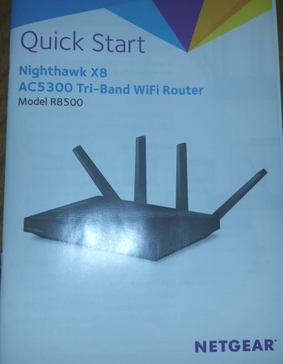
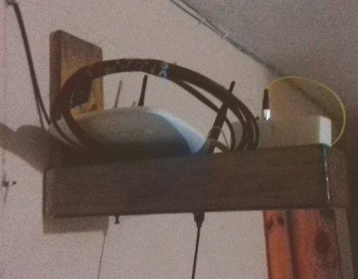
WIFI: Wireless Communication
Notes:
Cont. Wireless Communication setup.

Slide 22
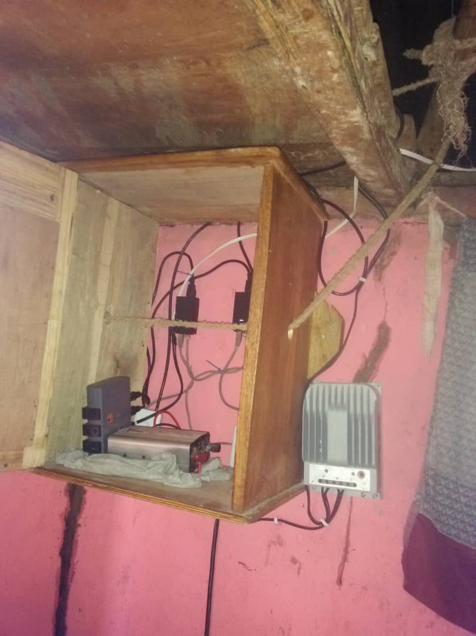
Sou Platon relaying the sigal between Gwomon and Kalabat

Slide 23
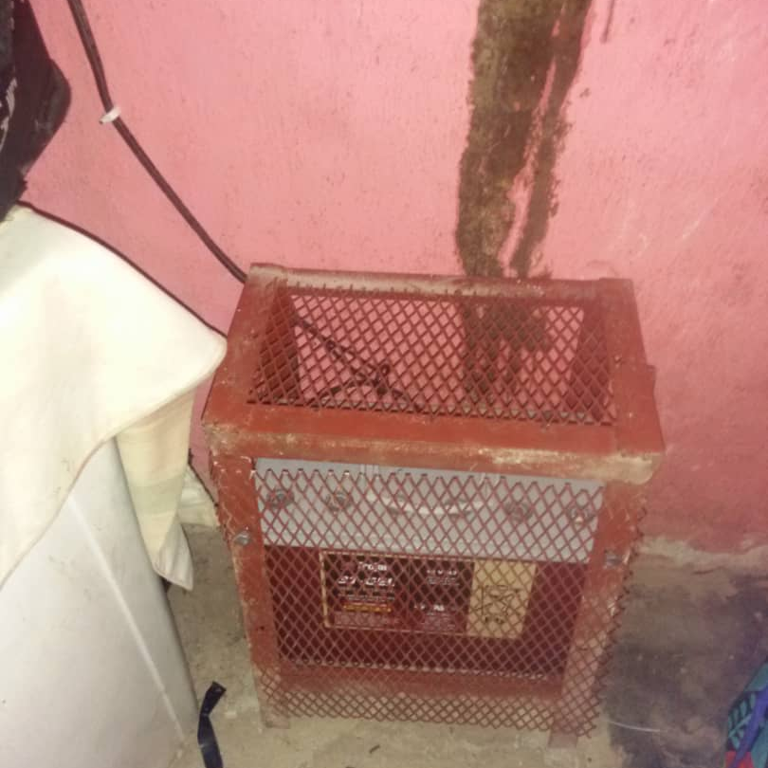
Sou Platon relaying the sigal between Gwomon and Kalabat

Slide 24
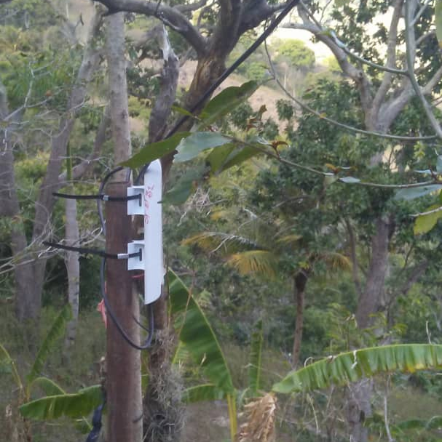
Sou Platon relaying the sigal between Gwomon and Kalabat

Slide 25
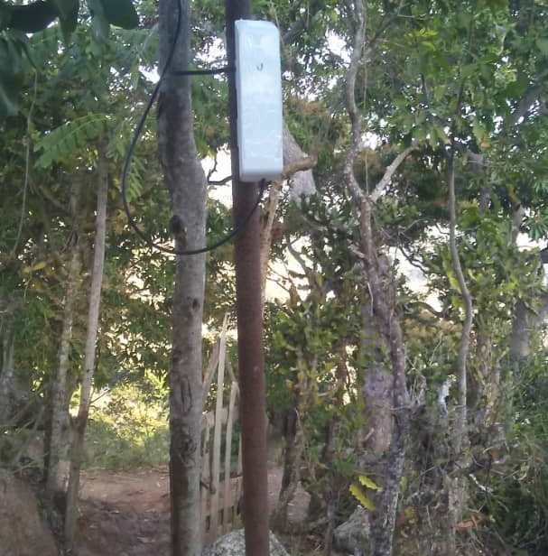
Sou Platon relaying the sigal between Gwomon and Kalabat

Slide 26
St. Jude Catholic Community
Goals for Year 2020
Water System and Reforestation
Solar Lanterns
Kindergarten (Education)
Wireless Communication
Notes:
Goals for Year 2020
Water System and Reforestation
Solar Lanterns
Kindergarten (Education)
Wireless Communication

Slide 27
St. Jude Catholic Community
For more information
Go to our website: www.judeparish.org
Select Haiti Relief in the Main Menu
Your donation or contribution is voluntarily no collection is taken at Mass.
You can also contact Fr. Bart or bring an envelope with your donation.
Fr. Bart is traveling to Haiti on December 26th
God Bless
Bible Scripture:
Isaiah 58: 5-7 True worship is to work for justice and care for the poor and oppressed.
Notes:
For more information.
Go to our website: www.judeparish.org
Select Haiti Relief in the Main Menu
Your donation or contribution is voluntarily no collection is taken at Mass.
You can also contact Fr. Bart or bring an envelope with your donation.
Fr. Bart is traveling to Haiti on December 26th
God Bless
Bible Scripture:
Isaiah 58: 5-7 True worship is to work for justice and care for the poor and oppressed.

